Slide 1

Implementation of Non-linear Solvers in C++

Slide 2
Overview
Implied volatility
Well-known numerical methods for solving non-linear equations:
  Bisection Method
  Newton-Raphson Method
Three implementations of these methods:
  Function pointers
  Virtual functions
  Function templates
Computing implied volatility

Slide 3
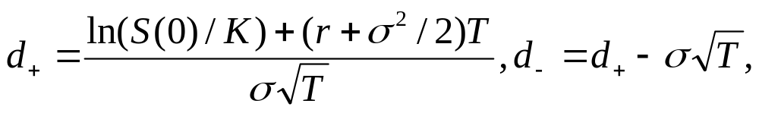
Implied Volatility
Within the Black-Scholes model, the price of a European call option with expiry time T and strike price K is given by the Black-Scholes Formula:
Where S(0) is the price of the underlying stock (the spot price), σ is the stock volatility, r is the continuously compounded interested and where

Slide 4
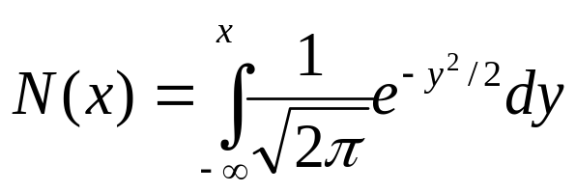
is the distribution function of the standard normal distribution N(0,1), with mean 0 and variance 1.
Among these variables, T and K are known quantities written into the option contract. Quotes for the current stock price S(0) and the interest rate r are also readily available.
One popular way of estimating σ is to look up the market price C_{quote} quoted from some European call option and then to solve the non-linear equation:
  C(S(0), K, T, σ, r) = C_{quote} , σ is called implied volatility.

Slide 5
Bisection method
We want to compute a solution x to an equation: f(x) = c
  where f is given function from an interval [a, b] to R. It is assumed that f is continuous on [a, b] and f(a)-c, f(b)-c have opposite signs. Then there must be an x є [a, b], such that f(x) = c.
The bisection method works by constructing sequence l_{n}, r_{n} of left and right approximation by induction:
  Let l₀ = a, r₀ = b
  If l_{n} and r_{n} have already been constructed for some n = 0, 1, 2,…, let
    l_{n+1} = l_{n}, r_{n+1} = (l_{n} + r_{n})/2 if f(l_{n})-c and f((l_{n}+r_{n})/2)-c have opposite signs.
    l_{n+1} = (l_{n} + r_{n})/2, r_{n+1} = r_{n}, otherwise
  Then l_{n} ↗ x and r_{n} ↘ x as n -> ∞, where x є [a, b] is a solution to f(x) = c.

Slide 6
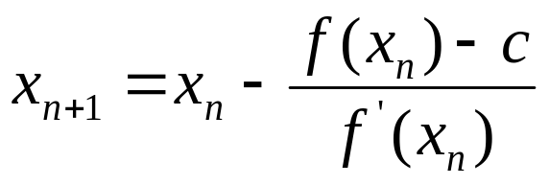
Newton-Raphson Method
In the case f is assumed to be differentiable on [a, b]. We construct a sequence x_{n} as followings:
  Take x₀ є (a, b)
  For n = 0, 1, … let
If the equation f(x) = c has a solution x є (a, b) such as f’(x) ≠ 0 and x₀ is chosen close enough to x, then x_{n} will converge to x.

Slide 7
Solver01.h - implementing Function Pointers
#ifndef Solver01_h
#define Solver01_h
double SolveByBisect(double(*Fct)(double x),
double Tgt, double LEnd, double REnd, double Acc)
{
double left=LEnd, right=REnd, mid=(left+right)/2;
double y_left=Fct(left)-Tgt, y_mid=Fct(mid)-Tgt;
while (mid-left>Acc)
{
if ((y_left>0 && y_mid>0)||(y_left<0 && y_mid<0))
{left=mid; y_left=y_mid;}
else right=mid;
mid=(left+right)/2;
y_mid=Fct(mid)-Tgt;
}
return mid;
}

Slide 8
Solver01.h (continue)
double SolveByNR(double(*Fct)(double x),
double(*DFct)(double x), double Tgt, double Guess, double Acc)
{
double x_prev=Guess;
double x_next=x_prev-(Fct(x_prev)-Tgt)/DFct(x_prev);
while (x_next-x_prev>Acc || x_prev-x_next>Acc)
{
x_prev=x_next;
x_next=x_prev-(Fct(x_prev)-Tgt)/DFct(x_prev);
}
return x_next;
}
#endif

Slide 9
Notes:
  The function SolveByBisect()is defined to implemented the bisection method.
    Care is taken in SolveByBisect() that only one evaluation of f is made for each loop iteration in order to speed up computation.
  SolveByNR() implements the Newton-Raphson solver.
    It takes two functions Fct and DFct so that both a function f and its derivative f’ can be passed.
    It takes arguments Tgt for target value c, Guess for the initial term x₀ of the approximating sequence, and Acc for the desired accuracy to be reached before the algorithm is terminated.
    The iteration x_{n} converge to an x such that f(x) = c if f’(x) ≠ 0 and x₀ is close enough to x.

Slide 10
Main15.cpp
The following code shows how to solve the equation f(x) = 0 for f(x) = x² – 2 by means of SolveByBisect() and SolvebyNR().
  #include "Solver01.h"
  #include <iostream>
  using namespace std;
  double F1(double x){return x*x-2;}
  double DF1(double x){return 2*x;}
  int main()
  { double Acc=0.001;
  double LEnd=0.0, REnd=2.0;
  double Tgt=0.0;
  cout << "Root of F1 by bisect: “ << SolveByBisect(F1,Tgt,LEnd,REnd,Acc) << endl;
  double Guess=1.0;
  cout << "Root of F1 by Newton-Raphson: " << SolveByNR(F1,DF1,Tgt,Guess,Acc) << endl;
  return 0;
  }

Slide 11
Notes:
Function pointers are simple enough, but limit the possibilities for expansion.
But it would not be easy to handle a function with a parameter, for example, f(x, a) = x² – a.

Slide 12
Solver02.h – implementing virtual functions
#ifndef Solver02_h
#define Solver02_h
class Function
{
public:
virtual double Value(double x)=0;
virtual double Deriv(double x)=0;
};

Slide 13
Solver02.h (continue)
double SolveByBisect(Function* Fct,
double Tgt, double LEnd, double REnd, double Acc)
{
double left=LEnd, right=REnd, mid=(left+right)/2;
double y_left=Fct->Value(left)-Tgt, y_mid=Fct->Value(mid)-Tgt;
while (mid-left>Acc)
{
if ((y_left>0 && y_mid>0)||(y_left<0 && y_mid<0))
{left=mid; y_left=y_mid;}
else right=mid;
mid=(left+right)/2;
y_mid=Fct->Value(mid)-Tgt;
}
return mid;
}

Slide 14
Solver02.h (continue)
double SolveByNR(Function* Fct, double Tgt, double Guess, double Acc)
{
double x_prev=Guess;
double x_next=x_prev -(Fct->Value(x_prev)-Tgt)/Fct->Deriv(x_prev);
while (x_next-x_prev>Acc || x_prev-x_next>Acc)
{
x_prev=x_next;
x_next=x_prev -(Fct->Value(x_prev)-Tgt)/Fct->Deriv(x_prev);
}
return x_next;
}
#endif

Slide 15
Notes:
  An abstract class called Function is introduced to represent a general function f. The class has two pure virtual member functions: Value() to return the value of f at x, and Deriv() to return the value of the derivative f’ at x.
  Fct is passed to SolveByBisect() and SolveByNR() as a pointer to the Function class, and both Value() and Deriv() can be accessed through the pointer Fct:
    Fct->Value(x_prev) returns the value of the function at x_prev.
    Fct->Derive(x_prev) returns the derivative at x_prev.
  Some concrete functions can now be introduced as subclasses of Function class.

Slide 16
Main16.cpp
#include "Solver02.h"
#include <iostream>
using namespace std;
class F1: public Function
{ public:
double Value(double x){return x*x-2;}
double Deriv(double x){return 2*x;}
};
class F2: public Function
{ private:
double a; //parameter
public:
F2(double a_){a=a_;}
double Value(double x){return x*x-a;}
double Deriv(double x){return 2*x;}
}

Slide 17
int main()
{
F1 MyF1;
F2 MyF2(3.0);
double Acc=0.001, LEnd=0.0, REnd=2.0, Tgt=0.0;
cout << "Root of F1 by bisect: " << SolveByBisect(&MyF1,Tgt,LEnd,REnd,Acc) << endl;
cout << "Root of F2 by bisect: " << SolveByBisect(&MyF2,Tgt,LEnd,REnd,Acc) << endl;
double Guess=1.0;
cout << "Root of F1 by Newton-Raphson: " << SolveByNR(&MyF1,Tgt,Guess,Acc) << endl;
cout << "Root of F2 by Newton-Raphson: " << SolveByNR(&MyF2,Tgt,Guess,Acc) << endl;
return 0;
}

Slide 18
Notes:
  Class F1, a subclass of the Function.
  Class F2, a subclass of the Function, define a new function, f(x, a) = x²-a, which was hard to do with function pointers.
  Class F2 contains a constructor function:
    F2(double a_){a=a_;}
  The pointers, &MF1 and &MF2 are passed to SolveByBisect() and SolveByNR(). Both functions expect a pointer to an object of the parent class here, but instead of receive the pointers of derived classes. When the virtual functions Value() and Derive() are called via the pointer, they do their checking at run time and select the correct version to be executed- Polymorphism

Slide 19
Function Templates
Virtual functions performs type checking at run time. When it occurs inside a loop, it will possibly create noticeable computing time overheads.
Templates offer a technique that largely retains the advantage of virtual functions over the function pointers, but shifts type checking from runtime to compile time. In some cases of heavy computations, it could mean measurable runtime savings for the end user.

Slide 20
Solver03.h
#ifndef Solver03_h
#define Solver03_h
template<typename Function>
double SolveByBisect(Function* Fct, double Tgt, double LEnd, double REnd, double Acc)
{
double left=LEnd, right=REnd, mid=(left+right)/2;
double y_left=Fct->Value(left)-Tgt, y_mid=Fct->Value(mid)-Tgt;
while (mid-left>Acc)
{
if ((y_left>0 && y_mid>0)||(y_left<0 && y_mid<0))
{left=mid; y_left=y_mid;}
else right=mid;
mid=(left+right)/2;
y_mid=Fct->Value(mid)-Tgt;
}
return mid;
}

Slide 21
template<typename Function>
double SolveByNR(Function* Fct, double Tgt, double Guess, double Acc)
{
double x_prev=Guess;
double x_next=x_prev -(Fct->Value(x_prev)-Tgt)/Fct->Deriv(x_prev);
while (x_next-x_prev>Acc || x_prev-x_next>Acc)
{
x_prev=x_next;
x_next=x_prev -(Fct->Value(x_prev)-Tgt)/Fct->Deriv(x_prev);
}
return x_next;
}
#endif

Slide 22
Main17.cpp
#include "Solver03.h"
#include <iostream>
using namespace std;
class F1
{
public:
double Value(double x){return x*x-2;}
double Deriv(double x){return 2*x;}
};
class F2
{
private:
double a; //parameter
public:
F2(double a_){a=a_;}
double Value(double x){return x*x-a;}
double Deriv(double x){return 2*x;}
};

Slide 23
int main()
{
F1 MyF1;
F2 MyF2(3.0);
double Acc=0.001;
double LEnd=0.0, REnd=2.0;
double Tgt=0.0;
cout << "Root of F1 by bisect: " <<SolveByBisect<F1>(&MyF1,Tgt,LEnd,REnd,Acc) << endl;
cout << "Root of F2 by bisect: "<< SolveByBisect<F2>(&MyF2,Tgt,LEnd,REnd,Acc) << endl;
double Guess=1.0;
cout << "Root of F1 by Newton-Raphson: “ << SolveByNR<F1>(&MyF1,Tgt,Guess,Acc)
<< endl;
cout << "Root of F2 by Newton-Raphson: “ << SolveByNR<F2>(&MyF2,Tgt,Guess,Acc)
<< endl;
return 0;
}

Slide 24
Notes:
Function has become a template parameter. The Function class is gone. SolveByBisect() and SolveByNR() have become function templates.
F1 and F2 are no longer subclasses. However, when &MyF1 is passed, it substitutes class F1 for the parameter Function. When compiling the code. When &MyF2 is passed, then it substitutes F2 and compiles another version of the code. There will be two different versions of SolveByBisect(), one for F1 and the other for F2, as well as two version of SolveByNR().
If more functions were involved, it can result in long compile time and large .exe file.

Slide 25
Assignment #1
Alter the code in Solver03.h and Main17.cpp to have an object of type Function passed by reference to SolveByBisect() and SolveByNR() rather than a pointer to an object of type Function passed to them.

Slide 26
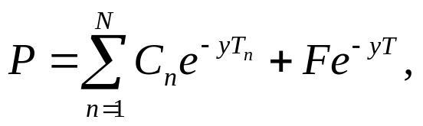
Assignment #2
The yield y of a coupon with face value F, maturity T, and fixed coupon C₁, ….C_{N} payable at times 0 < T₁ < … < T_{n} = T satisfies:
  Where P is the bond price at time 0.
Using Solver03.h, write a program to compute the yield of a coupon bond by solving the above non-linear equation.

Slide 27
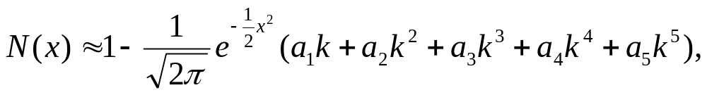

Computing Implied Volatility
The normal distribution can be implemented using the following rational function approximation:
For x ≥ 0
For x < 0
Where k = (1+γx)⁻¹, and where γ, a₁, a₂, a₃, a₄, a₅ are suitably chosen constant.

Slide 28
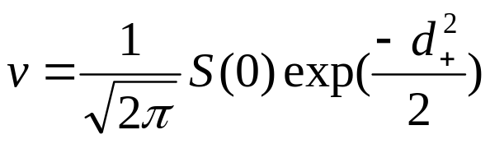
To compute the implied volatility using Newton-Raphson solver, we also need an expression for the derivative of the European call option price with respect to volatility σ. This derivative, called vega, is given by:

Slide 29
EurCall.h
#ifndef EurCall_h
#define EurCall_h
class EurCall
{
public:
double T, K;
EurCall(double T_, double K_){T=T_; K=K_;}
double d_plus(double S0, double sigma, double r);
double d_minus(double S0, double sigma, double r);
double PriceByBSFormula(double S0, double sigma, double r);
double VegaByBSFormula(double S0, double sigma, double r);
};
#endif

Slide 30
EurCall.cpp
#include "EurCall.h"
#include <cmath>
double N(double x)
{
double gamma = 0.2316419; double a1 = 0.319381530;
double a2 =-0.356563782; double a3 = 1.781477937;
double a4 =-1.821255978; double a5 = 1.330274429;
double pi = 4.0*atan(1.0); double k = 1.0/(1.0+gamma*x);
if (x>=0.0)
{
return 1.0-((((a5*k+a4)*k+a3)*k+a2)*k+a1)*k*exp(-x*x/2.0)/sqrt(2.0*pi);
}
else return 1.0-N(-x);
}

Slide 31
double EurCall::d_plus(double S0, double sigma, double r)
{
return (log(S0/K)+(r+0.5*pow(sigma,2.0))*T)/(sigma*sqrt(T));
}
double EurCall::d_minus(double S0, double sigma, double r)
{
return d_plus(S0,sigma,r)-sigma*sqrt(T);
}
double EurCall::PriceByBSFormula(double S0, double sigma, double r)
{
return S0*N(d_plus(S0,sigma,r)) -K*exp(-r*T)*N(d_minus(S0,sigma,r));
}
double EurCall::VegaByBSFormula(double S0, double sigma, double r)
{
double pi=4.0*atan(1.0);
return S0*exp(-d_plus(S0,sigma,r)*d_plus(S0,sigma,r)/2)*sqrt(T)/sqrt(2.0*pi);
}

Slide 32
Notes:
The EurCall class contains the variables T, K, a constructor function, member functions for calculating option price, vega, as well as auxillary functions to compute d₊ and d₋.
The distribution function N(x) is computed using rational function approximation.
The function PriceByBSFormula() computes the option price from the Black-Scholes formula.
VegaByBSFormula() computes the vega parameter.

Slide 33
Main18.cpp
#include "Solver03.h"
#include "EurCall.h"
#include <iostream>
using namespace std;
class Intermediary: public EurCall
{ private:
double S0,r;
public:
Intermediary(double S0_, double r_, double T_, double K_) : EurCall(T_,K_) {S0=S0_; r=r_;}
double Value(double sigma)
{
return PriceByBSFormula(S0,sigma,r);
}
double Deriv(double sigma)
{
return VegaByBSFormula(S0,sigma,r);
}
};

Slide 34
int main()
{
double S0=100.0;
double r=0.1;
double T=1.0;
double K=100.0;
Intermediary Call(S0,r,T,K);
double Acc=0.001;
double LEnd=0.01, REnd=1.0;
double Tgt=12.56;
cout << "Implied vol by bisect: “ << SolveByBisect< Intermediary>(&Call,Tgt,LEnd,REnd,Acc) << endl;
double Guess=0.23;
cout << "Implied vol by Newton-Raphson: “ << SolveByNR < Intermediary>(&Call,Tgt,Guess,Acc) << endl;
return 0;
}

Slide 35
Notes:
The subclass Intermediary of the EurCall class translates PriceByBSFormula() and VegabyBSFormula() into Value() and Derive() functions.
  The constructor function of the Intermediary class calls the constructor of the EurCall class to initialize T, K, S0 and r.
  Value() is connected to PriceByBSFormula() .
  Derive() is connected to VegabyBSFormula().
Tgt is initialized with the observed call price C_{quote.}
Implied volatility is calculated by bisection solver and the New-Raphson solver.

Slide 36
References
Numerical Methods in Finance with C++ (Mastering Mathematical Finance), by Maciej J. Capinski and Tomasz Zastawniak, Cambridge University Press, 2012, ISBN-10: 0521177162
Financial Instrument Pricing Using C++, Daniel J. Duffy, ISBN 0470855096, Wiley, 2004.

